Slide 1
My Work IQ: three months of my work, understood
The last 3 months (20 Jul to 21 Oct 2026), built automatically from the work I already do
▶ Microsoft's Work IQ slide
Business data
Customers (13)
Retail Customer A
Retail Customer C
Wholesale Customer B
Products (5)
Copilot Studio
Microsoft 365 Copilot
Copilot and agents
2,604
Microsoft 365 Copilot
emails
Programmes (4)
Store manager Copilot pilot
Merchandising agent build
331
Copilot Chat
calendar events
Copilot Studio agents
260
My
Work IQ
Teams chats (group and 1:1)
69
People (8)
Account colleague
Solution architect
Themes and concerns (5)
Holiday readiness
Frontline worker licensing
What it produced for me
files I worked on
Pilot scorecard
Weekly pilot digest
Store manager prompt pack
OneDrive and SharePoint
= 3,264 signals
Assets and agents (4)
Pilot scorecard
Weekly pilot digest
Escalations (6)
Escalation 1
0 things tagged or uploaded
▶ Explore in 3D
Context
Memory
Skills
Connects information, people and business context.
Recalls what matters across weeks.
Turns understanding into outcomes.
45 entities, 7 types, 54 relationships
Frontline licensing peaked in August (17 in the week of 10 Aug), then eased to about 2 a week in October.
Grounded in 284 emails and calendar events with Retail Customer A, its escalations and its sponsor.
Why it's different:
Built from work I already do
Respects my permissions and sensitivity labels
One foundation for Copilot and agents
Source: Sam Taylor's Outlook mail (junk and duplicate copies removed), calendar, Teams group and 1:1 chats, and the files I worked on in OneDrive and SharePoint, 20 Jul to 21 Oct 2026. Fictional sample data. Customer and people names anonymised. Interactive 3D version available.
Notes:
Read this left to right. On the left is my own raw work: emails, calendar events, chats and the files I worked on in OneDrive and SharePoint, with nothing tagged or uploaded. Work IQ turns that into context, memory and skills, shown by the clusters on the sphere and the three pillars along the bottom. On the right, the same foundation powers Copilot and agents. Every number here is mine, from three months (20 Jul to 21 Oct) of real work.
Files: 69 files I worked on in OneDrive and SharePoint (I edited 54 of them), counted in the 3,264 signals.
Click the sphere or Explore in 3D to open the interactive version (keep Work IQ Sphere (customer-safe).html in the same folder as this deck).
Microsoft's Work IQ slide (top right) jumps to Microsoft's official Work IQ slide, which is hidden in the slide show; Back to my Work IQ returns here.

Slide 2
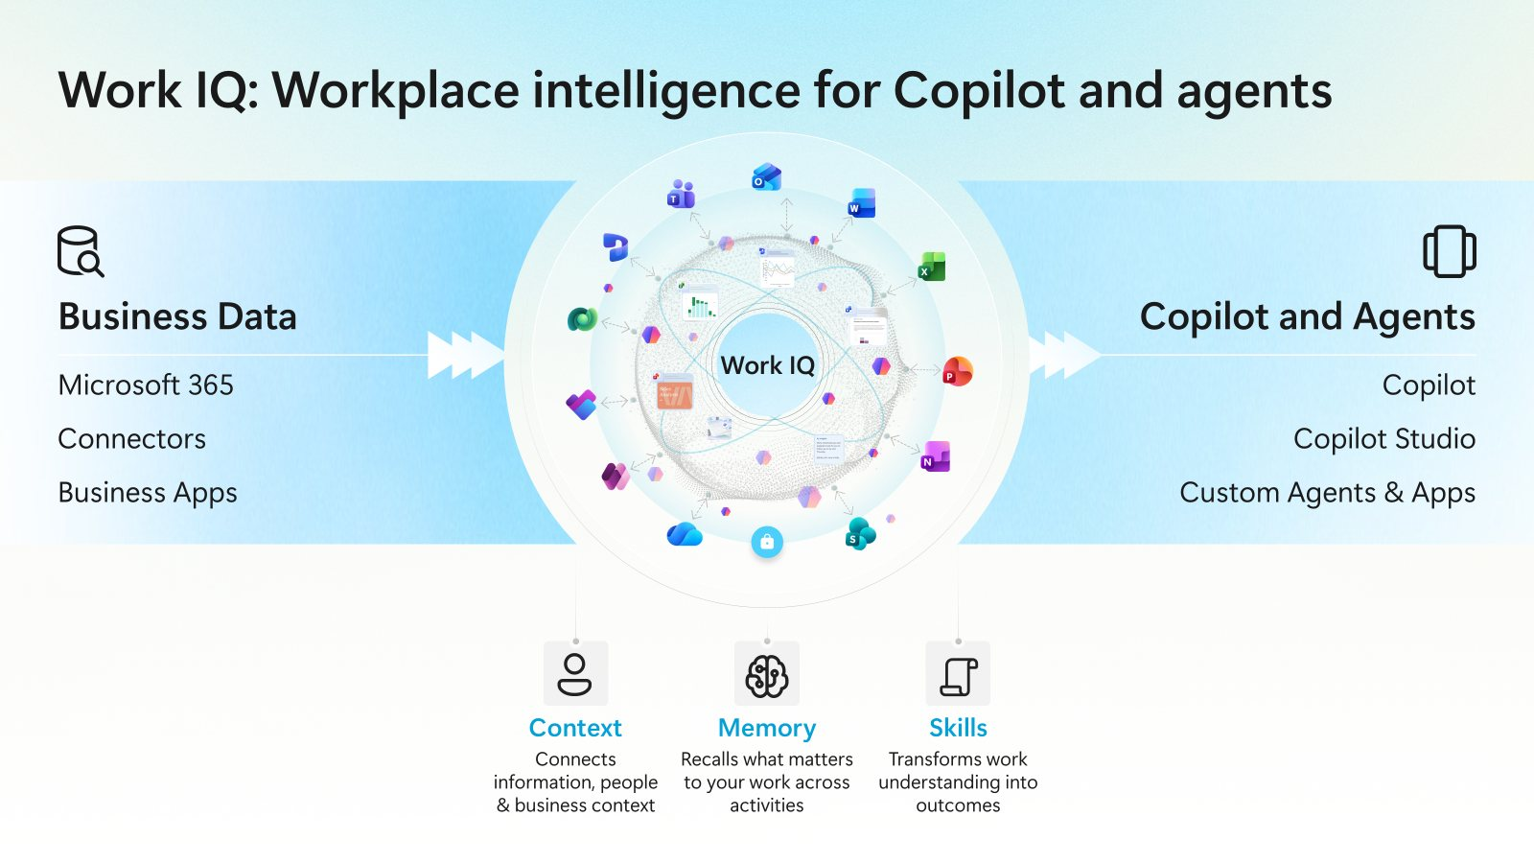
◀ Back to my Work IQ

